Slide 1
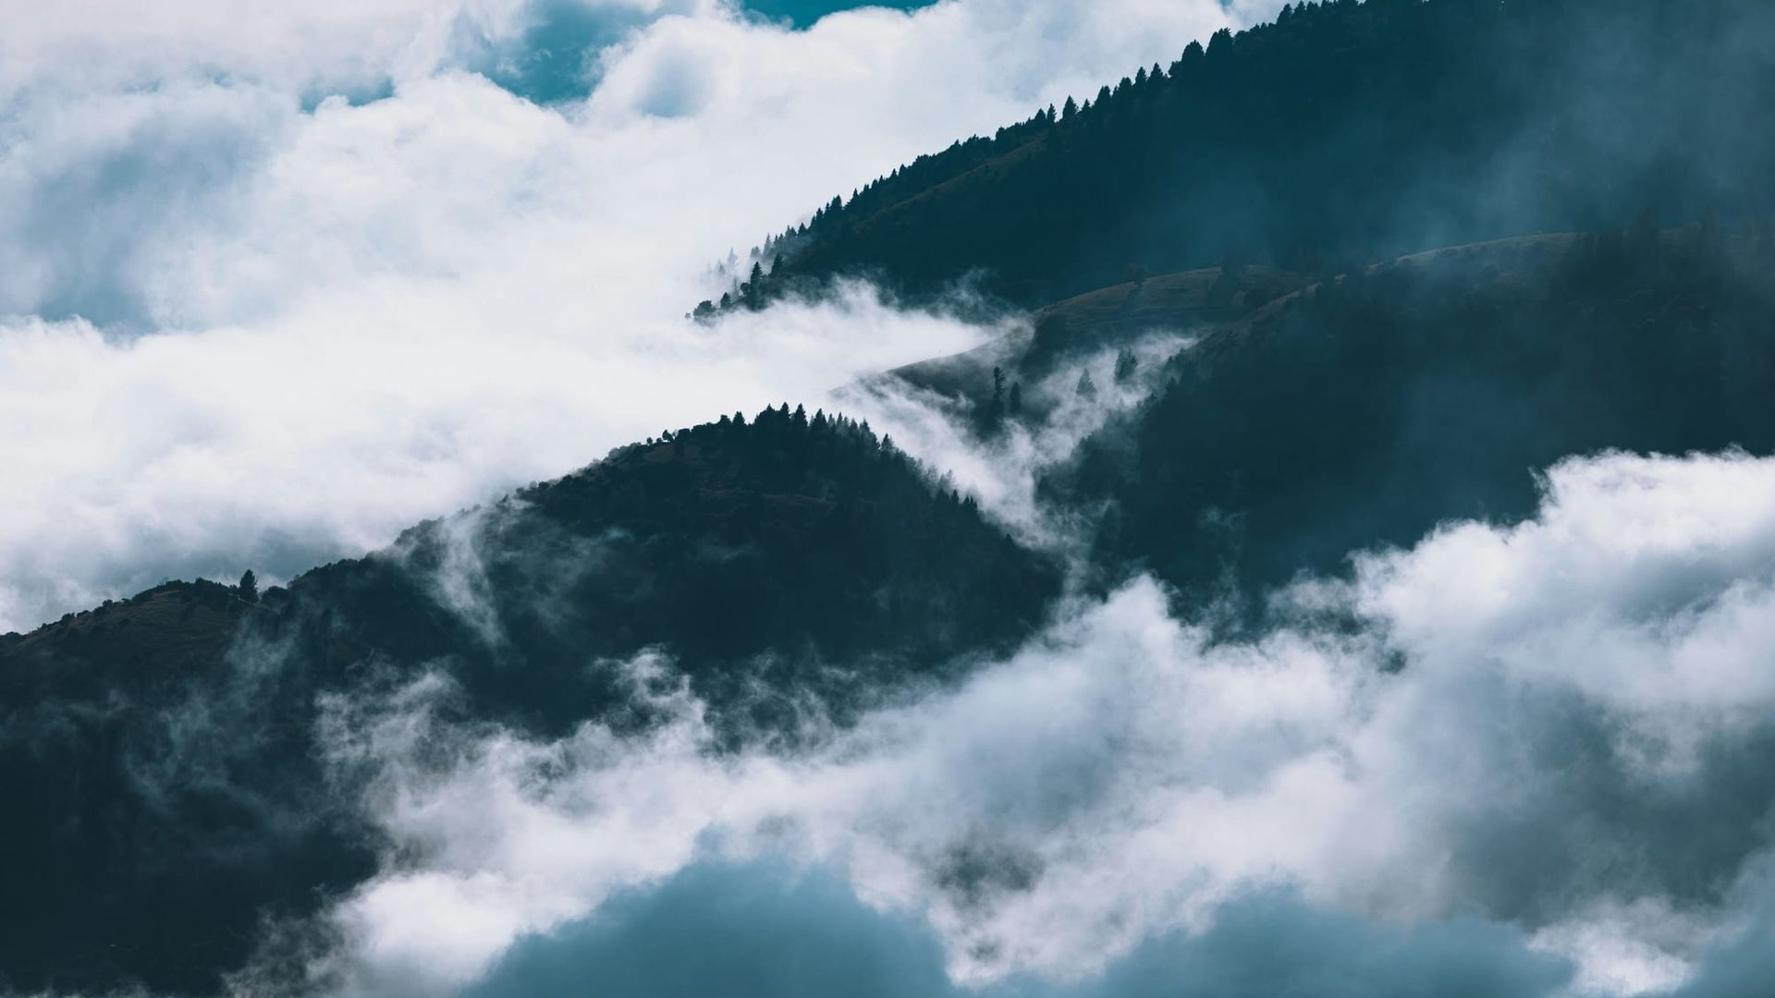


ALPINE ASCENTS
EXPLORE BEYOND THE ORDINARY
The Mountains
Are Calling.
A mountaineering education website: history, techniques, safety and records
Course CPISM Group D Batch Code 2606E2
PROJECT TEAM
YASHFEEN FATIMA
AREESHA JUNAID
ZAKRIA KHAN
MUHAMMAD HUZAIFA IQBAL
Student1733472
Student1733481
Student1734513
Student1733900
Notes:
Introduce the project: Alpine Ascents, a mountaineering education website built by Group D (course CPISM, batch code 2606E2). Introduce the four team members.

Slide 2
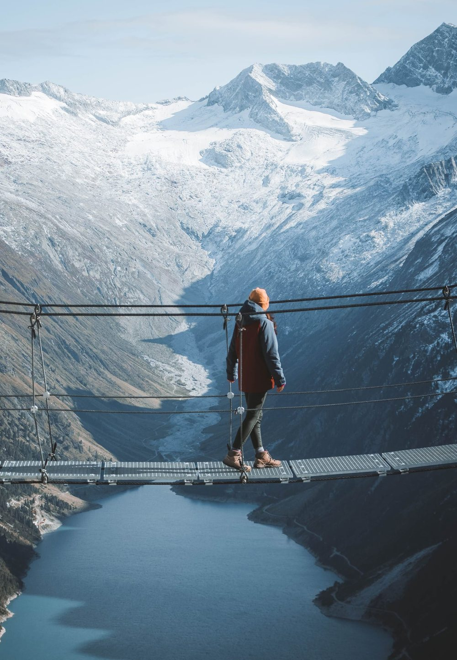

01 · PROJECT OVERVIEW
What Alpine Ascents is
An educational website on mountaineering: its history, styles, techniques, hazards, records and community, gathered into one connected site with photos, videos and interactive tools.
14
68 + 12
16
pages, one menu
photos and videos
climbing clubs mapped
PROBLEM STATEMENT
Mountaineering has no single rule book, so beginners piece it together from scattered sources, and for the untrained it can be dangerous. There is no one trusted place that teaches the history, the skills and the risks together.
Alpine Ascents · Group D · CPISM
02 / 13
Notes:
Overview: Alpine Ascents is an educational site with 14 pages, 68 photos, 12 videos and a world map of 16 climbing organisations. Problem: mountaineering knowledge is scattered and has no governing rule book, so beginners have no single trusted place to learn history, skills and risks together.

Slide 3
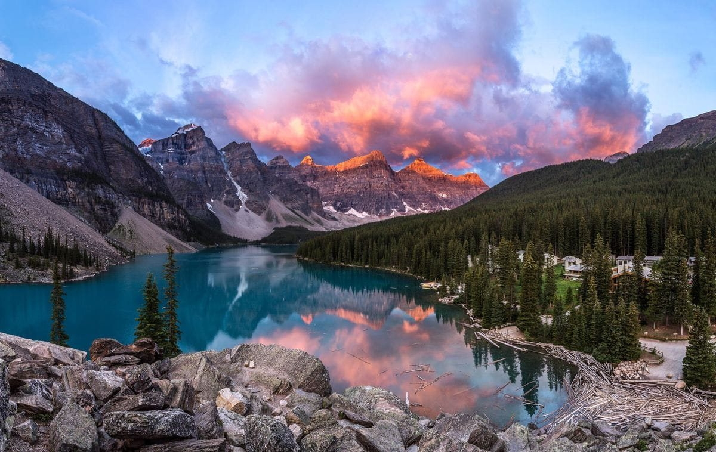
02 · SOLUTION AND OBJECTIVES
One website, every side of the mountain
Project Objectives
01
Teach the history, styles and techniques of mountaineering.
Alpine Ascents is a single, trusted guide on the web. It brings history, techniques, shelters and safety together, so a learner can go from curiosity to prepared climber in one place.
02
Put safety first with hazards, a checklist and emergency steps.
03
Celebrate records, including the five 8,000 m peaks in Pakistan.
04
Build a community with a clubs map, news and feedback.
LEARN · PREPARE · EXPLORE
Alpine Ascents · Group D · CPISM
03 / 13
Notes:
Solution: one clear website that covers history, equipment, techniques, shelters and safety. Objectives: teach, put safety first, celebrate records (five of the fourteen 8,000 m peaks are in Pakistan) and build a community.

Slide 4
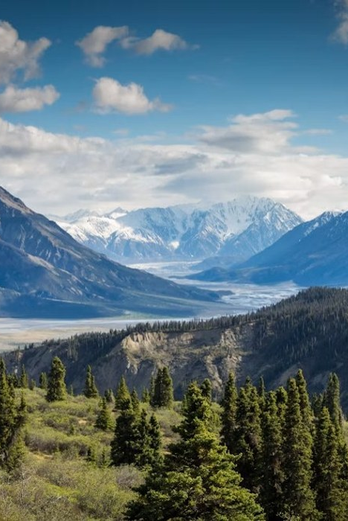
03 · MOUNTAINEERING BASICS
What is mountaineering?
More than climbing a mountain: a journey of preparation, courage, teamwork and respect for nature.
Also called mountain climbing, it is the sport of reaching, or attempting to reach, high points in mountainous regions.
WHERE IT GETS SERIOUS
It describes climbing where terrain and weather are hazardous enough that experience is needed for safety. There is no single rule book or governing body.
PREPARE · CLIMB · RESPECT
Alpine Ascents · Group D · CPISM
04 / 13
Notes:
What mountaineering is: also called mountain climbing, the sport of reaching, or trying to reach, high points in mountainous regions. It means climbing where terrain and weather are hazardous enough that experience is needed for safety, and there is no single rule book or governing body.

Slide 5
03 · HISTORY
A legacy of exploration
From the first climb of Mont Blanc to the first winter ascent of K2.
1786
1953
1964
2021
Mont Blanc is first climbed, marking the birth of modern mountaineering.
Everest and Nanga Parbat are climbed.
All fourteen 8,000-metre peaks have now been climbed.
First winter ascent of K2, the last 8,000er to fall in winter.
Alpine Ascents · Group D · CPISM
05 / 13
Notes:
Key milestones: 1786, Mont Blanc is first climbed and modern mountaineering begins. 1953, Everest and Nanga Parbat are climbed. 1964, all fourteen 8,000 m peaks have been climbed. 2021, first winter ascent of K2, the last 8,000er to fall in winter.

Slide 6
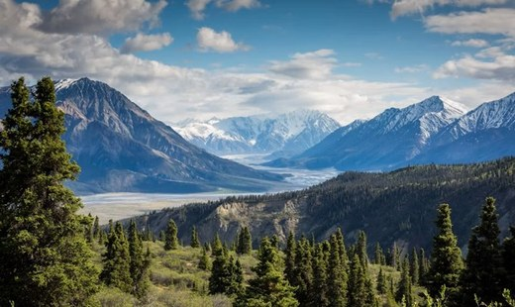
03 · TYPES AND STYLES
Five ways to climb
1
Trekking
2
Rock climbing
3
Ice and snow
Long walks through mountain country, without technical climbing.
Climbing rock faces with hands, feet and rope protection.
Crampons and ice axes on glaciers, snow slopes and frozen falls.
4
Alpine style
5
Expedition style
Light and fast: a small team climbs in one push.
Fixed camps and ropes, with supplies carried up in stages.
Alpine Ascents · Group D · CPISM
06 / 13
Notes:
Mountaineering comes in different styles: trekking, rock climbing, ice and snow climbing, alpine style (light and fast, one push by a small team) and expedition style (fixed camps and ropes, supplies carried up in stages).

Slide 7
03 · TECHNIQUES
Core climbing techniques
01
02
03
Rope work
Belaying
Crampons and ice axe
Knots, anchors and roped travel keep a team connected.
A partner manages the rope to stop a fall and protect the climber.
Steel spikes and a pick give grip on ice and steep snow.
04
05
06
Glacier travel
Acclimatization
Reading weather
Teams rope up to cross crevasses and snow bridges.
Climb high, sleep low: the body needs days to adapt to thin air.
Check forecasts and watch the sky; conditions change fast.
Alpine Ascents · Group D · CPISM
07 / 13
Notes:
Six core skills: rope work, belaying, crampons and ice axe, glacier travel, acclimatization (climb high, sleep low) and reading the weather. Together they keep a team connected, protected and adapted to the mountain.

Slide 8
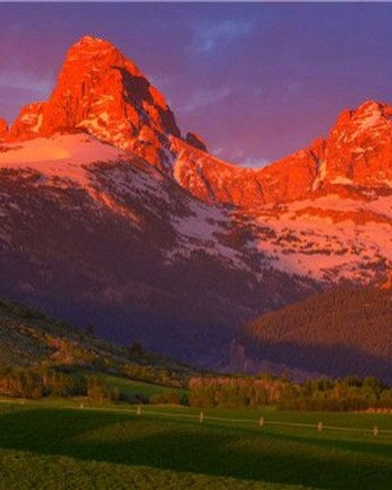
03 · HAZARDS
Know the hazards
Bad weather
Avalanches
Storms, whiteouts and wind arrive fast.
Unstable snow slopes can release without warning.
Falling rock
Extreme cold
Loose rock and ice fall from above.
Frostbite and hypothermia are constant risks.
Altitude
Crevasses
Thin air brings sickness and fatigue.
Hidden cracks lie under snow bridges.
Alpine Ascents · Group D · CPISM
08 / 13
Notes:
The six main hazards: bad weather, avalanches, falling rock, extreme cold, altitude and crevasses. Each one can change the day quickly, which is why preparation matters.

Slide 9
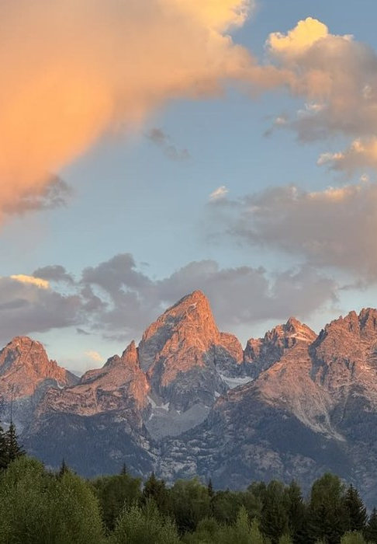
03 · SAFETY
Reach the summit. Return safely.
Most accidents happen on the way down, when climbers are tired.
1
Check weather forecasts before departure.
2
Choose suitable routes and train properly.
3
Carry appropriate gear and emergency supplies.
4
Climb with experienced guides when needed.
5
Respect nature and follow local safety advice.
Alpine Ascents · Group D · CPISM
09 / 13
Notes:
Safety rules: check the forecast, choose suitable routes and train, carry the right gear and emergency supplies, climb with experienced guides when needed, and respect nature and local advice. Most accidents happen on the descent, when climbers are tired.

Slide 10
03 · RECORDS
The world’s highest peaks
The top five all rise in the Himalaya and Karakoram, across Nepal, China, India and Pakistan.
8,849 m
Mount Everest, the highest mountain on Earth.
14
mountains above 8,000 metres
1953
first confirmed ascent of Everest
Alpine Ascents · Group D · CPISM
10 / 13
Notes:
The five highest mountains on Earth are Everest (8,849 m), K2 (8,611 m), Kangchenjunga (8,586 m), Lhotse (8,516 m) and Makalu (8,485 m). All rise in the Himalaya and Karakoram. There are fourteen mountains above 8,000 m, and five of them are in Pakistan.

Slide 11
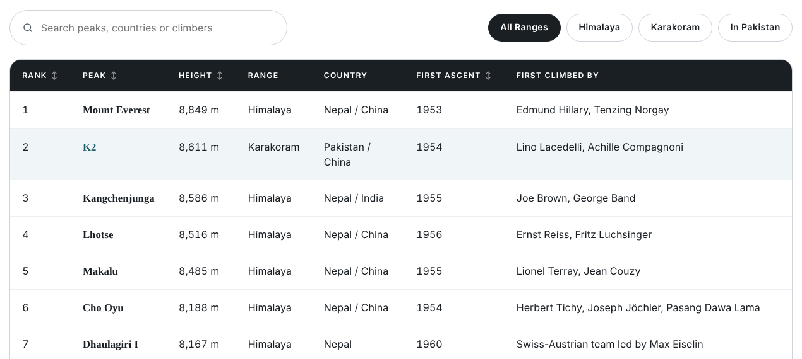



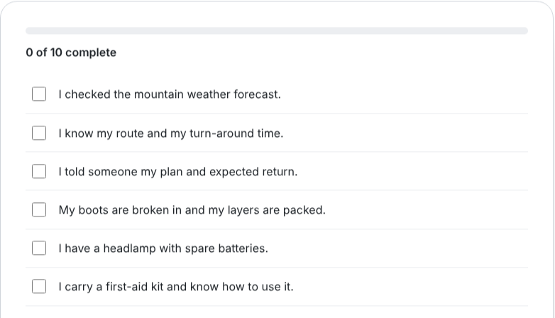

04 · KEY FEATURES AND TECHNOLOGY
Built to explore, simple to run
Plain HTML, CSS and JavaScript. No build step and no server code.
Key features
Search, filter and sort tables
Checklist that saves your ticks
Clubs map with distance lookup
Shelter booking with live total
Technology
HTML5
CSS3
JavaScript
Live pages from the site: the 8,000 m peaks table and the pre-climb checklist
Leaflet maps
localStorage
Alpine Ascents · Group D · CPISM
11 / 13
Notes:
Features: searchable and sortable tables on the Records page, a safety checklist that remembers ticks in the browser, a Leaflet and OpenStreetMap clubs map with a find-clubs-near-me button, and a shelter booking form with a live price total. Technology: plain HTML5, CSS3 and JavaScript, no build step or server code; visitor details are kept in the browser (localStorage) only.

Slide 12
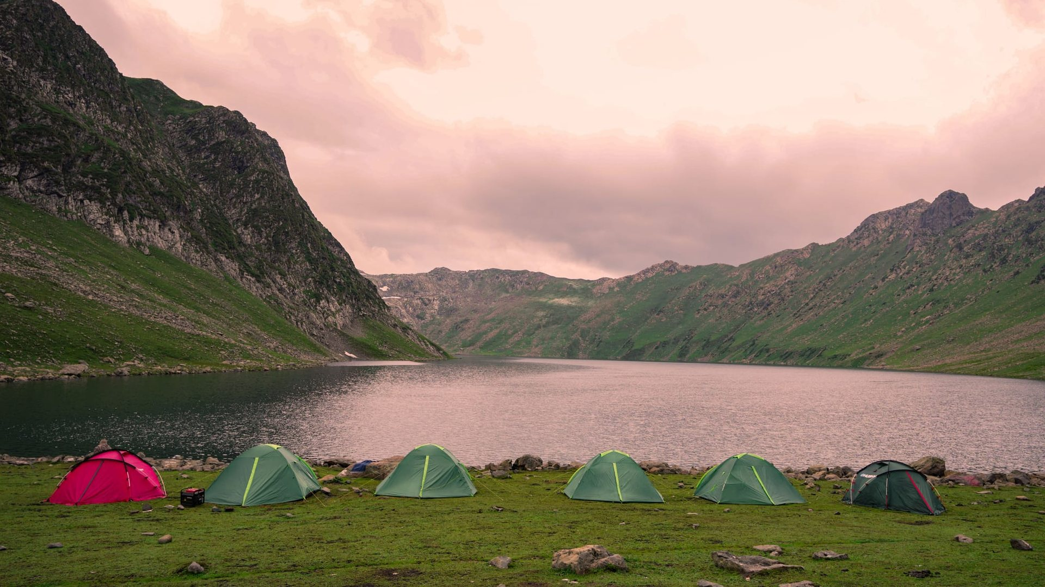
05 · CHALLENGES AND BENEFITS
Hurdles we cleared
Benefits and Target Users
1
A lot of content across 14 pages
One shared stylesheet and one script per page keep the look and menu consistent.
WHO IT IS FOR
Beginners and trekkers
Students and researchers
Campers planning shelters
Climbing clubs and fans
2
Phones, tablets and desktops
The layout adapts, and below about 1,120 px the menu folds into a button.
3
Photos and maps need the internet
Local photos where possible, plus a troubleshooting table in the user guide.
WHAT THEY GAIN
Trusted facts in one place
Safer trip preparation
Access on any device
4
Protecting visitor details
Everything stays in the visitor’s own browser. Nothing is sent anywhere.
Notes:
Challenges: managing content across 14 pages, responsive design, dependence on internet-loaded photos and maps, and keeping visitor data private. Target users: beginners, students, campers and clubs. Benefits: trusted information, safer preparation and access on any device.

Slide 13
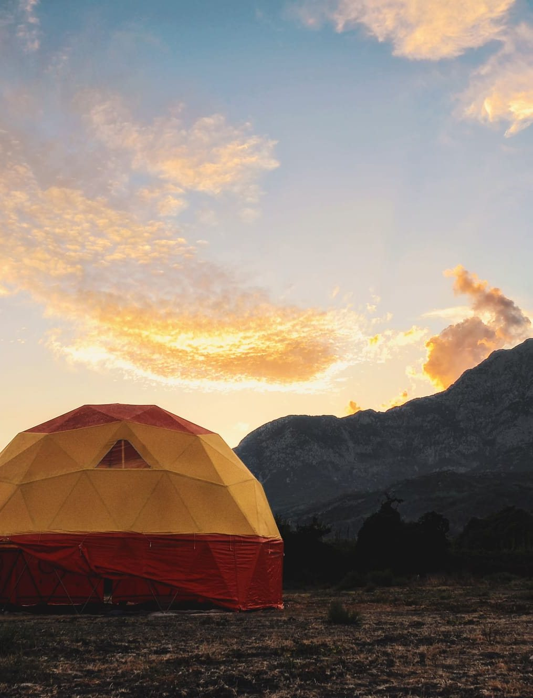
06 · FUTURE SCOPE AND CONCLUSION
Future scope
Live weather and route data for each peak
User accounts and saved trips with a real database
Real shelter booking and payments
Urdu and other languages, plus a mobile app
Conclusion
Alpine Ascents turns scattered mountain knowledge into one clear, safe and interactive guide. Reach the summit, and return safely.
Thank you
Group D · CPISM · 2606E2
Notes:
Future scope: live weather and route data, user accounts with a real database, real booking and payments, and more languages including Urdu plus a mobile app. Conclusion: Alpine Ascents turns scattered mountain knowledge into one clear, safe and interactive guide. Thank the audience and invite questions.

